Slide 1
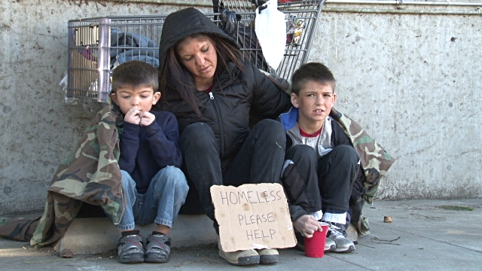
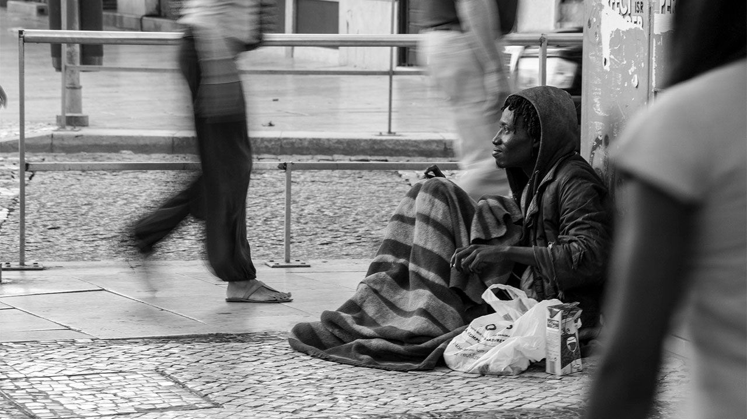
Investigating Homelessness in the U.S.
Chidima Okorie, Ugonma Ibeabuchi & Julia Gajda

Slide 2

Our Hypothesis
What is the relationship of homeless rates with the US population size and the funding allocated in various US states for Beds (for individuals who are homeless)?
The greater the general U.S. population size, the greater the rate of homelessness and vice versa.

Slide 3


Datasets Sources:
Department of Housing and Urban Development (HUD) data
Homeless Population, estimated Point In Time count for 2018.
Housing Inventory Count, 2018
https://www.hudexchange.info/resource/3031/pit-and-hic-data-since-2007/
United States Census Bureau data
Estimated U.S. Census data for 2018
https://www.census.gov/data/datasets/time-series/demo/popest/2010s-national-total.html

Slide 4
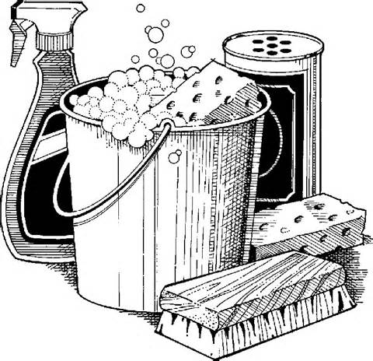
Data Exploration
What we found:
Our datasets had too many variables and not enough variable
Missing values wasn’t an issue with our datasets
Relationship between our variables wasn’t quite clear when we looked at the data manually, however, once we began to build charts to visualize it, it became clear.
Rate of homelessness in a state was significantly lower than the general population size.
Most states seem to have # of beds available that are relative to the rate of homelessness
Double checked/calculated our data through data aggregation
- Now, we know how to properly visualize our data in a meaningful way.
Data Cleaning
For our individual data sources, we had to:
Remove the additional rows above the title row
Convert each file from excel to csv
Dropped redundant and
Once data was aggregated, we had to:
Dropped rows with US territories
Dropped regional data

Slide 5
Do State Population Size Affect Homeless Rate?
Notes:
CHIDIMA
Talk about our assumption of the greater the state size the greater the homeless rate and vice versa.

Slide 6
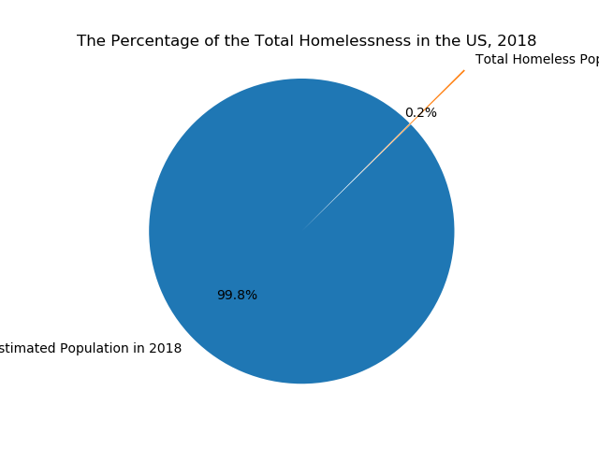
Notes:
We found that .2% of the US population experienced homelessness in 2018

Slide 7
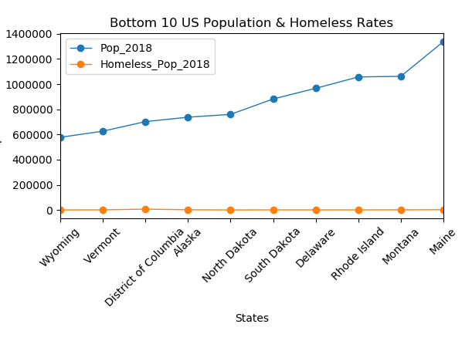
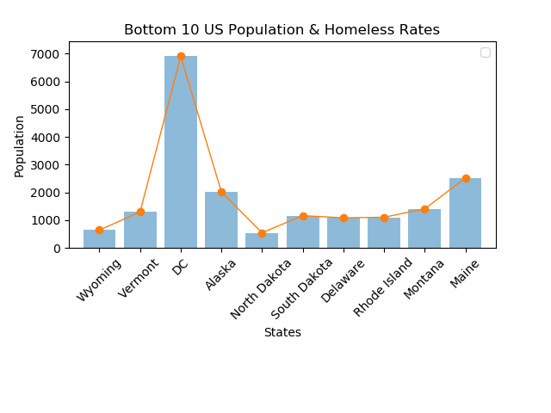
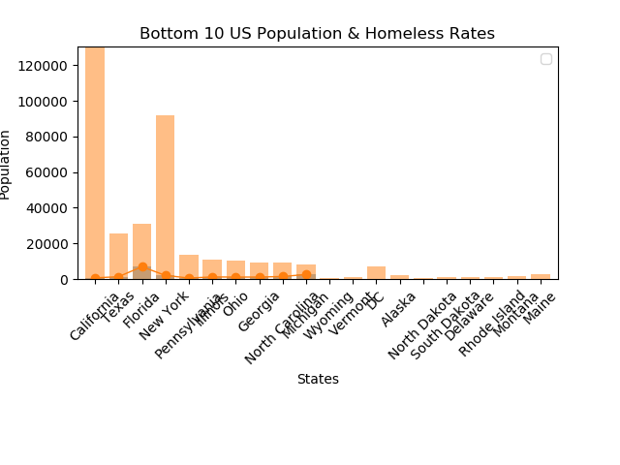

Slide 8
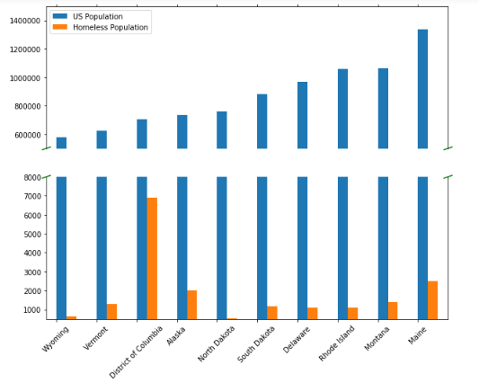
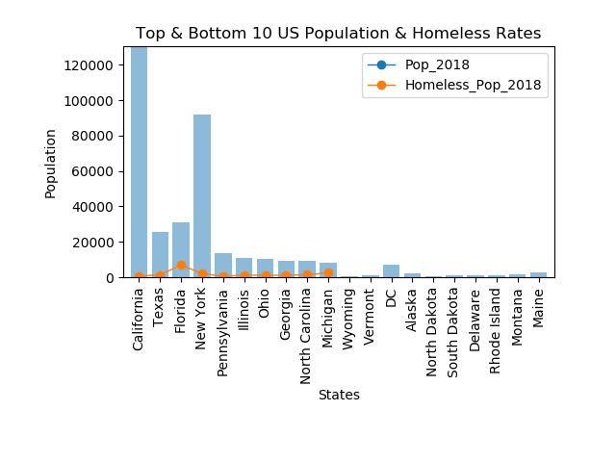
Notes:
We found there was no correlation between homeless rate and gen. population

Slide 9
Is There A Type Of Homelessness That Is Prevalent In The US?

Slide 10
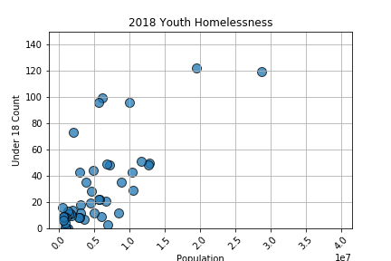
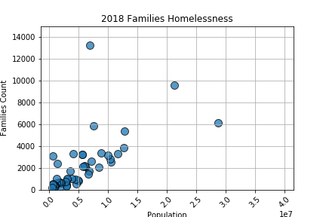
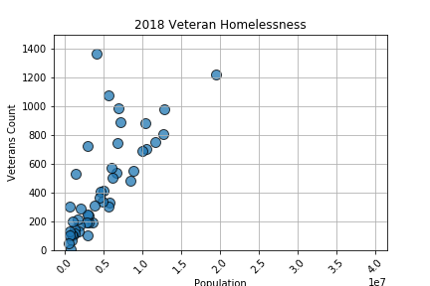
Notes:
Discuss the limitation in this “estimated” data

Slide 11
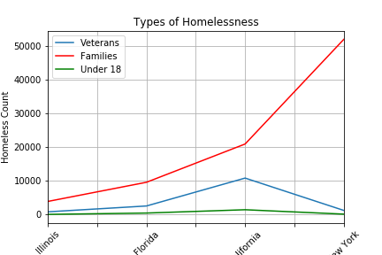
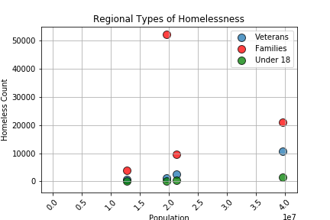

Slide 12
Do States Provide Beds Based On Number Of Homeless Individuals?

Slide 13
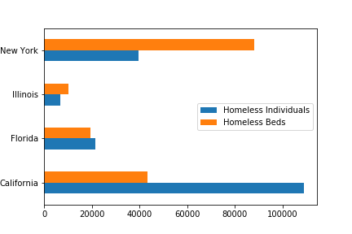
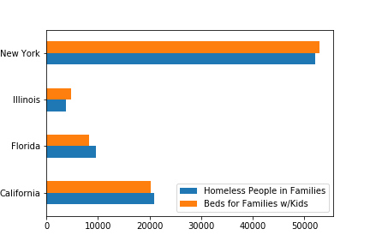
Are there enough beds to accommodate the # of estimated homeless individuals four of US’ largest states?
According to our analysis:
New York = 👍
Illinois = 👍
Florida = 👎
California = 👎
Limitations to the data.
Are there enough beds to accommodate the # of estimated homeless people in families in four of US’ largest states?
According to our analysis:
New York = 👍
Illinois = 👍
Florida = 👎
California = 👎
Limitations to the data.
Notes:
Discuss the limitation in this “estimated” data

Slide 14
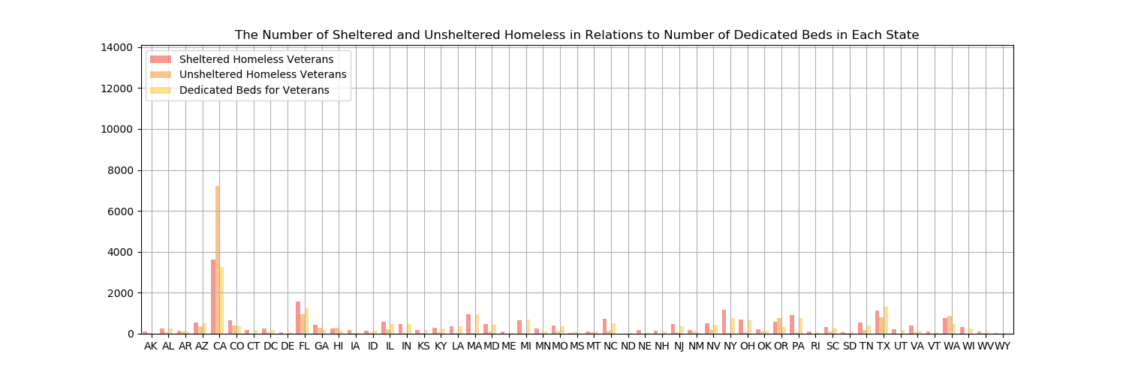
Notes:
Discuss the limitation in this “estimated” data

Slide 15
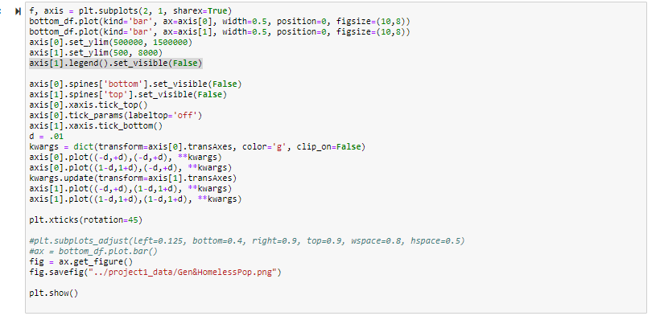
BREAKING THE BAR!

Slide 17
Data Analysis
Read and merged files
Cleaned the merged data
Identified which columns to use and renamed them
Built data frames for each of our charts
Confirmed the data types were correct – integers, floats etc.
Started plotting: Bar, Horizontal Bar, Pie Chart

Slide 18
OUR FINDINGS:
Homeless individuals make up
Our findings: In the beds for dedicated youths (Under 25 years old), we found that a majority of the states do not have a CoC of any sorts for youths under the age of 25. This could be that there isn't a demand for it, or the numbers are too low to support CoC for those under 25 years. Another finding we came across that the number of beds and housing are in short supply in many of the states. And there are a portion of homeless population who are "sleeping rough".In addition we found that the latest information on homeless people, they make up less than 1% of the US population and only like 0.2% of the population are homeless.
The implications of this findings is that we can assume that some regions are not receiving adequate funding due to the growth of homelessness or people who fall victim to homelessness are unaware of the resources to help them transition back into living on their own and hopefully not return to homelessness.

Slide 19
WHAT DOES THIS MEAN?

Slide 20
Are there enough beds to accommodate the # of estimated homeless individuals four of US’ largest states?
Notes:
Discuss the limitation in this “estimated” data

Slide 21
INSERT JUPYTER CODE FOR EXPLORATION AND CLEANING

Slide 22
Thank you!
Questions?

